Slide 1

Core & Advanced Java Concepts

Slide 2


An internship report submitted in partial fulfillment of the requirements for the award of degree of
BACHELOR OF TECHNOLOGY
In
Artificial Intelligence & Data Science
Submitted by:
Vegi Prabhas
(23H45A4507)
DEPARTMENT OF ARTIFICIAL INTELLIGENCE AND DATA SCIENCE
2024-2025

Slide 3
Introduction to Java
Object-Oriented Programming
Platform Independence
Robust and Secure
Java is built upon the principles of object-oriented programming (OOP), which emphasizes data encapsulation, inheritance, and polymorphism. OOP helps create reusable and maintainable code.
Java's "Write Once, Run Anywhere" (WORA) principle allows code compiled on one platform to run seamlessly on others. This is achieved through the Java Virtual Machine (JVM).
Java incorporates a strong type system, memory management, and security features to ensure robust and reliable applications.

Slide 4
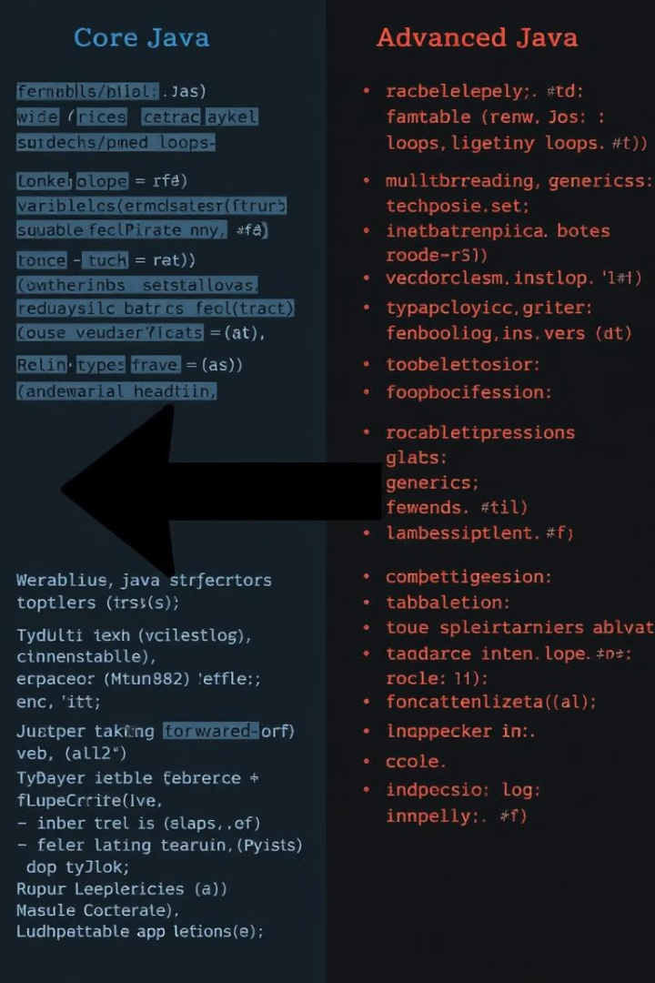
Core vs Advanced Java
Core Java
Advanced Java
The foundation of Java, encompassing basic syntax, data types, operators, control flow, classes, objects, and fundamental libraries.
Expands upon core concepts, delving into more complex topics like multithreading, network programming, database connectivity, and web development.

Slide 5
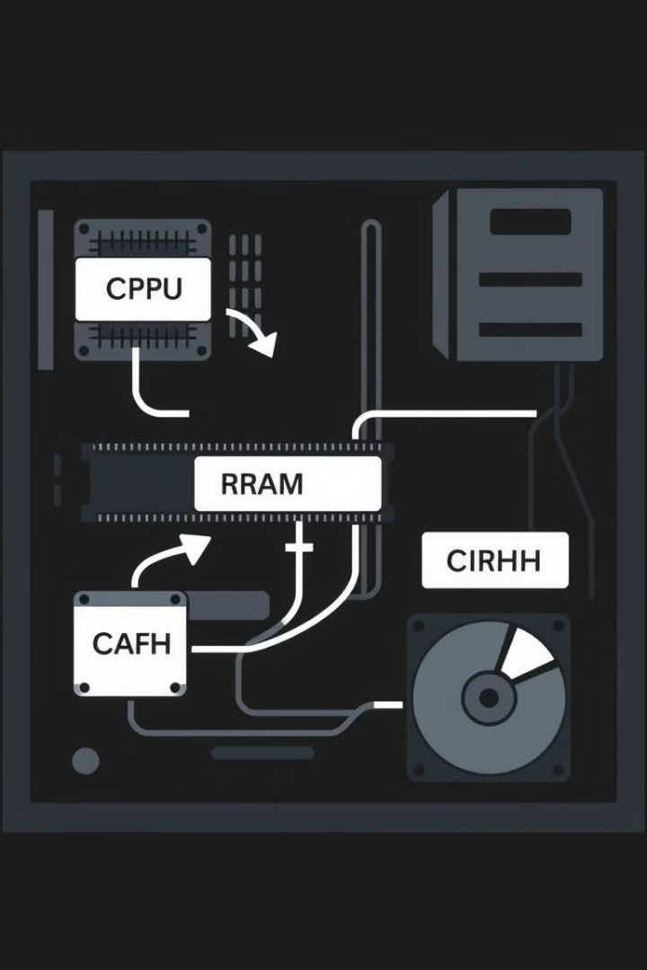
Core Java
Data Types & Variables
Control Flow
Control flow statements, like if-else, for loops, and while loops, are essential for managing the execution flow of your code.
Understanding the different data types and how to declare and use variables is crucial in any programming language.
Classes and Objects
Learning how to create classes and objects is fundamental to OOP and forms the basis for structuring your applications.

Slide 6




Advanced Java
Multithreading
Network Programming
Database Connectivity
Multithreading enables simultaneous execution of multiple tasks within a single program, enhancing performance and responsiveness.
Java offers powerful libraries for establishing connections, sending and receiving data, and interacting with networks.
Java provides frameworks for connecting to various databases, allowing you to store and retrieve data efficiently.

Slide 7



Snake Game using Java
Game Design
Planning the game's core logic: snake movement, food generation, collision detection.
GUI Implementation
Constructing the game's visual interface (using Java Swing or JavaFX): game board, snake, and score display.
Gameplay Logic
Implementing core game mechanics: user input handling, snake position updates, and collision management.

Slide 8

Tools and technologies
Java Programming Main programming language used for both backend and frontend logic.
IDE (Visual Studio Code) Tools used for coding, debugging, and managing the project.
Swing for creating the graphical user interface(GUI), used to render the game board, snake, and food.
AWT (Abstract Window Toolkit): for basic graphics and event handling.
JavaFX Used to build the graphical user interface (GUI) for the application.
Git/GitHub Version control system for managing project code and collaboration.
Core Java Concepts
o Collections: Arrays or lists to manage the snake's body parts.
o Multithreading: For handling real-time snake movement and game updates.
o Event handling: For capturing user input (e.g., keyboard controls).

Slide 9

Advantages of developing this project
The uses of the Snake game in Java span educational, practical, and entertainment domains.
Learning Programming Concepts: Helps beginners understand Java fundamentals such as loops, conditional statements, and OOP principles.
Hands-On Practice: Introduces practical programming topics like event handling, GUI development, and game mechanics.
Thread Management: Demonstrates how to manage threads for smooth game rendering and responsive controls.
Skill EnhancementAlgorithm Development: Involves implementing movement logic, collision detection, and dynamic game elements.
Graphics Programming: Teaches how to use Java libraries like Swing or JavaFX for rendering shapes, images, and animations.

Slide 10
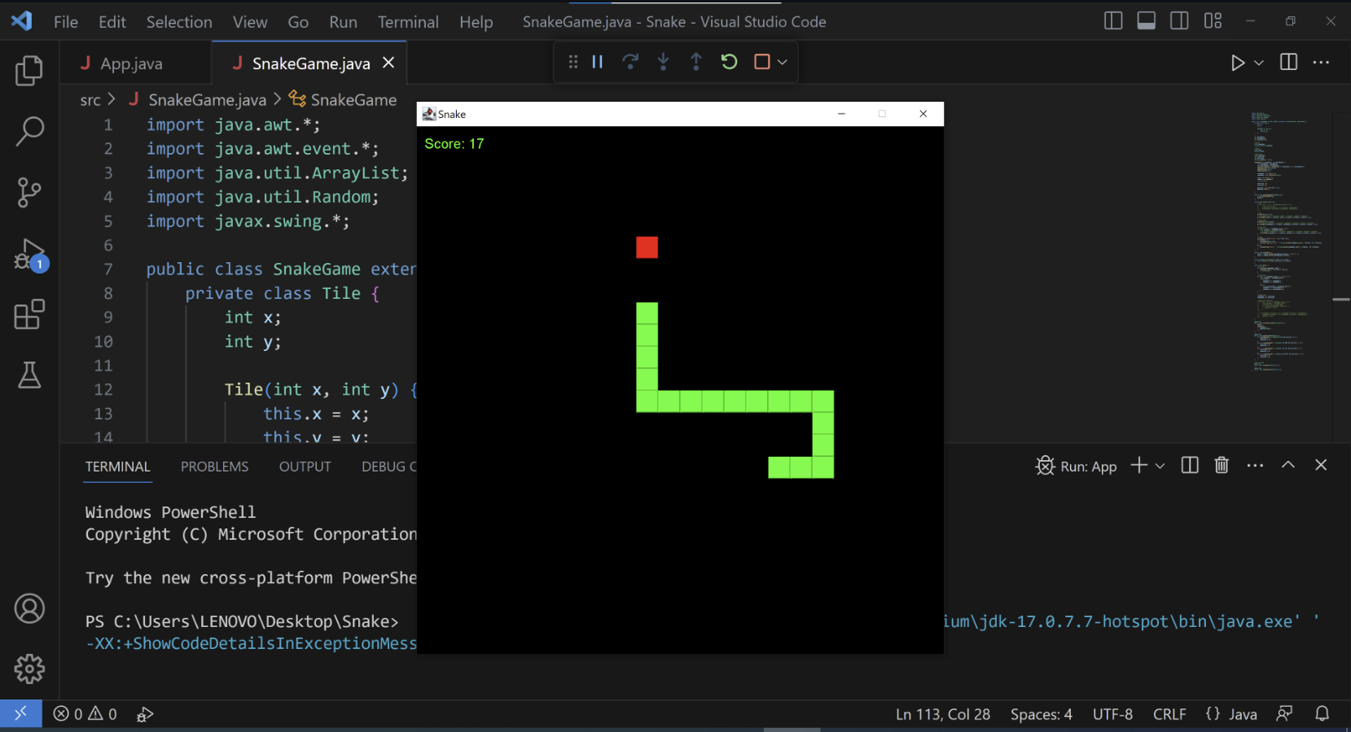

Slide 11

Thank You!
Submitted by:
Vegi Prabhas
(23H45A4507)

